Slide 1
CROSS PLATFORM APPLICATION
DEVELOPMENT
TEAM - 6
G. Aishwarya -2021SP93074
Sharadhi-2021SP93034
Pragti Singh-2021SP93061
Pratyush Sinha-2021SP93070
Mohit M-2021SP93069

Slide 2

PROJECT IDEA
Can I read the news only of the categories that I want to be constantly updated of, but I am tired of scrolling through all the news to reach/get a news I am interested in????
Yes, a solution to this is "Dope Scoop" is the go-to app which
gives you the news based on the categories you are interested
to avoid constant scrolling and get updates from the source
you trust in via verified channels.

Slide 3
FEATURES
Custom news feed based on selected sources
Saving articles
Explore news based on categories
Search for topics
Sharing articles

Slide 4
TECH STACK
FLUTTER : Flutter is an open-source mobile UI framework created by Google which allows us to develop cross platform applications
FIREBASE: Firebase is a set of hosting services for any type of application (Android, iOS, JavaScript, Node.js, Java, Unity, PHP, C++..). It is a platform developed by Google for creating mobile and web applications
GOOGLE SIGN IN: Flutter plugin for Google Sign-In, a secure authentication system for signing in with a Google account on Android and iOS.
FLUTTER WEBVIEW DESIGN: Plugin that allows Flutter to communicate with a native WebView.
News API: News API is a simple, easy-to-use REST API that returns JSON search results for current and historic news articles published by over 80,000 worldwide sources.

Slide 5

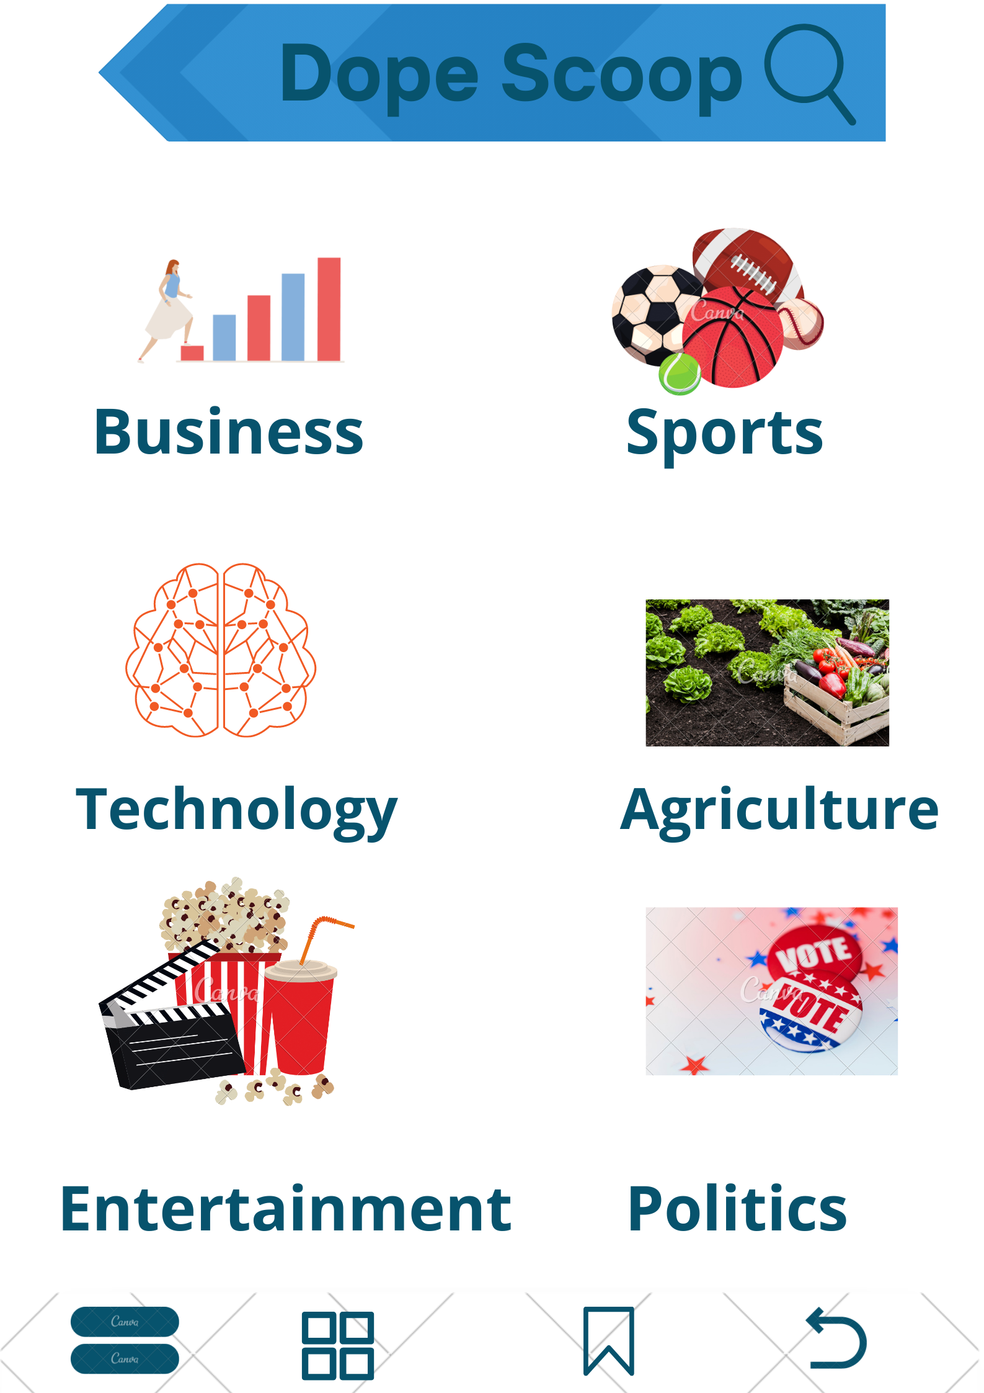
MOCK UI
(1)- Welcome page or the Landing page
(2)- When User clicks on the category button

Slide 6
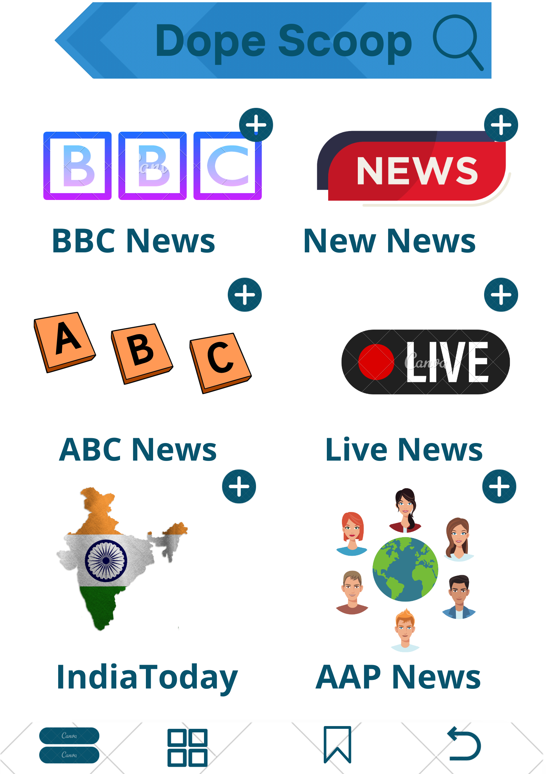
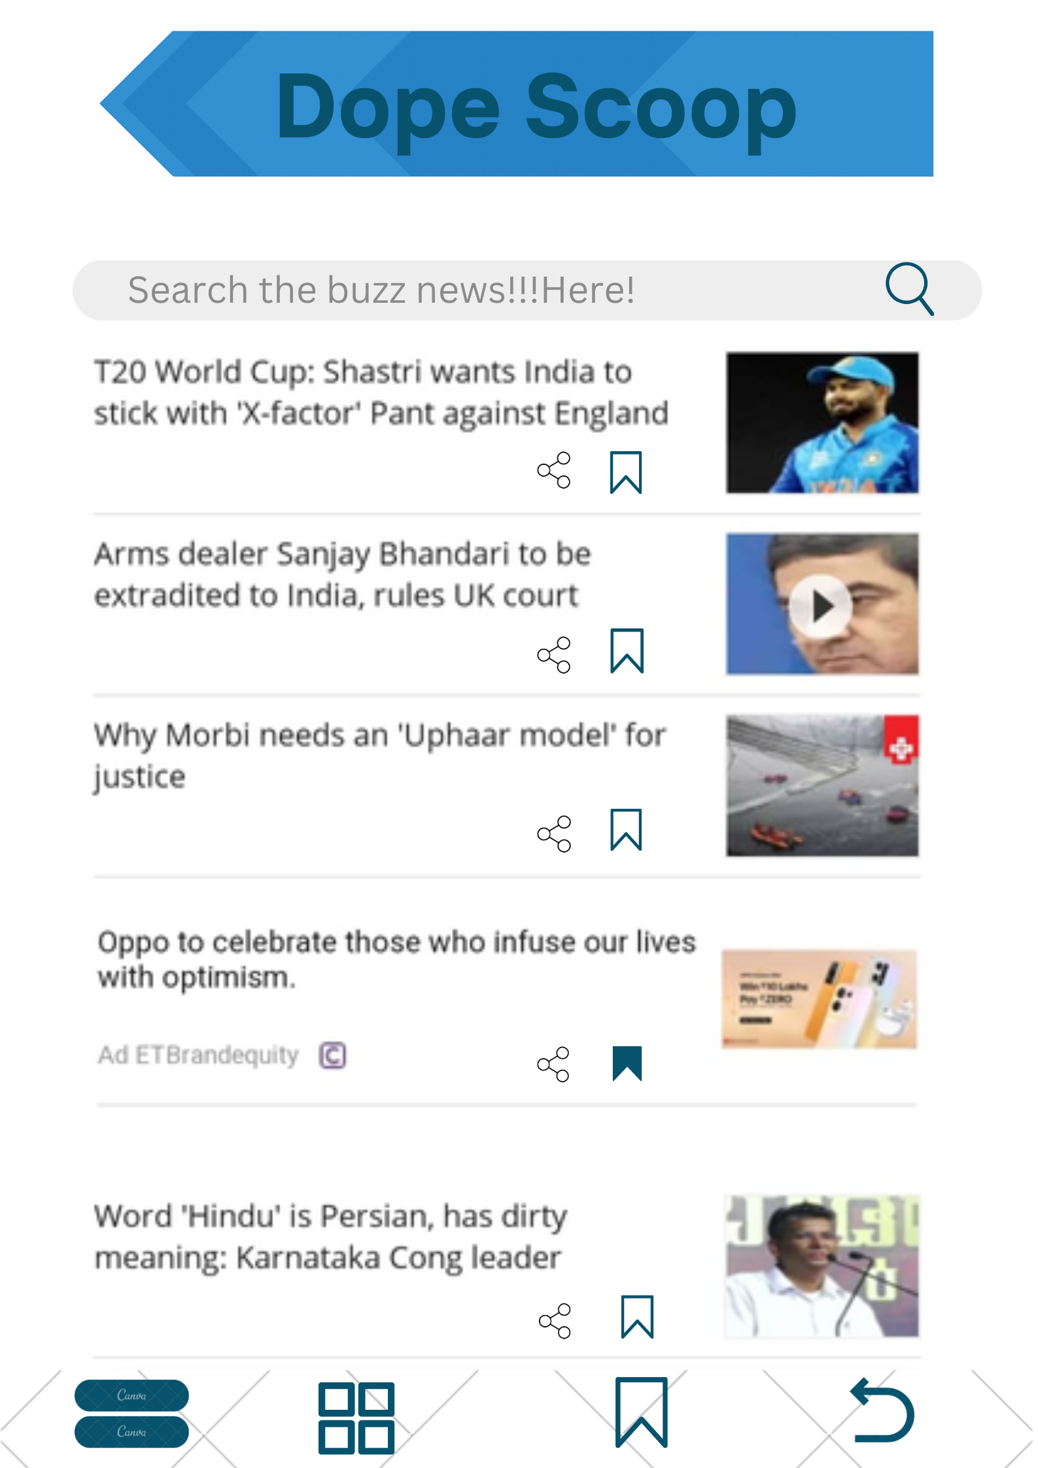
MOCK UI(Continued…)
(3)- When User clicks on the Channel Button
(4) - When User clicks on Search Icon

Slide 7
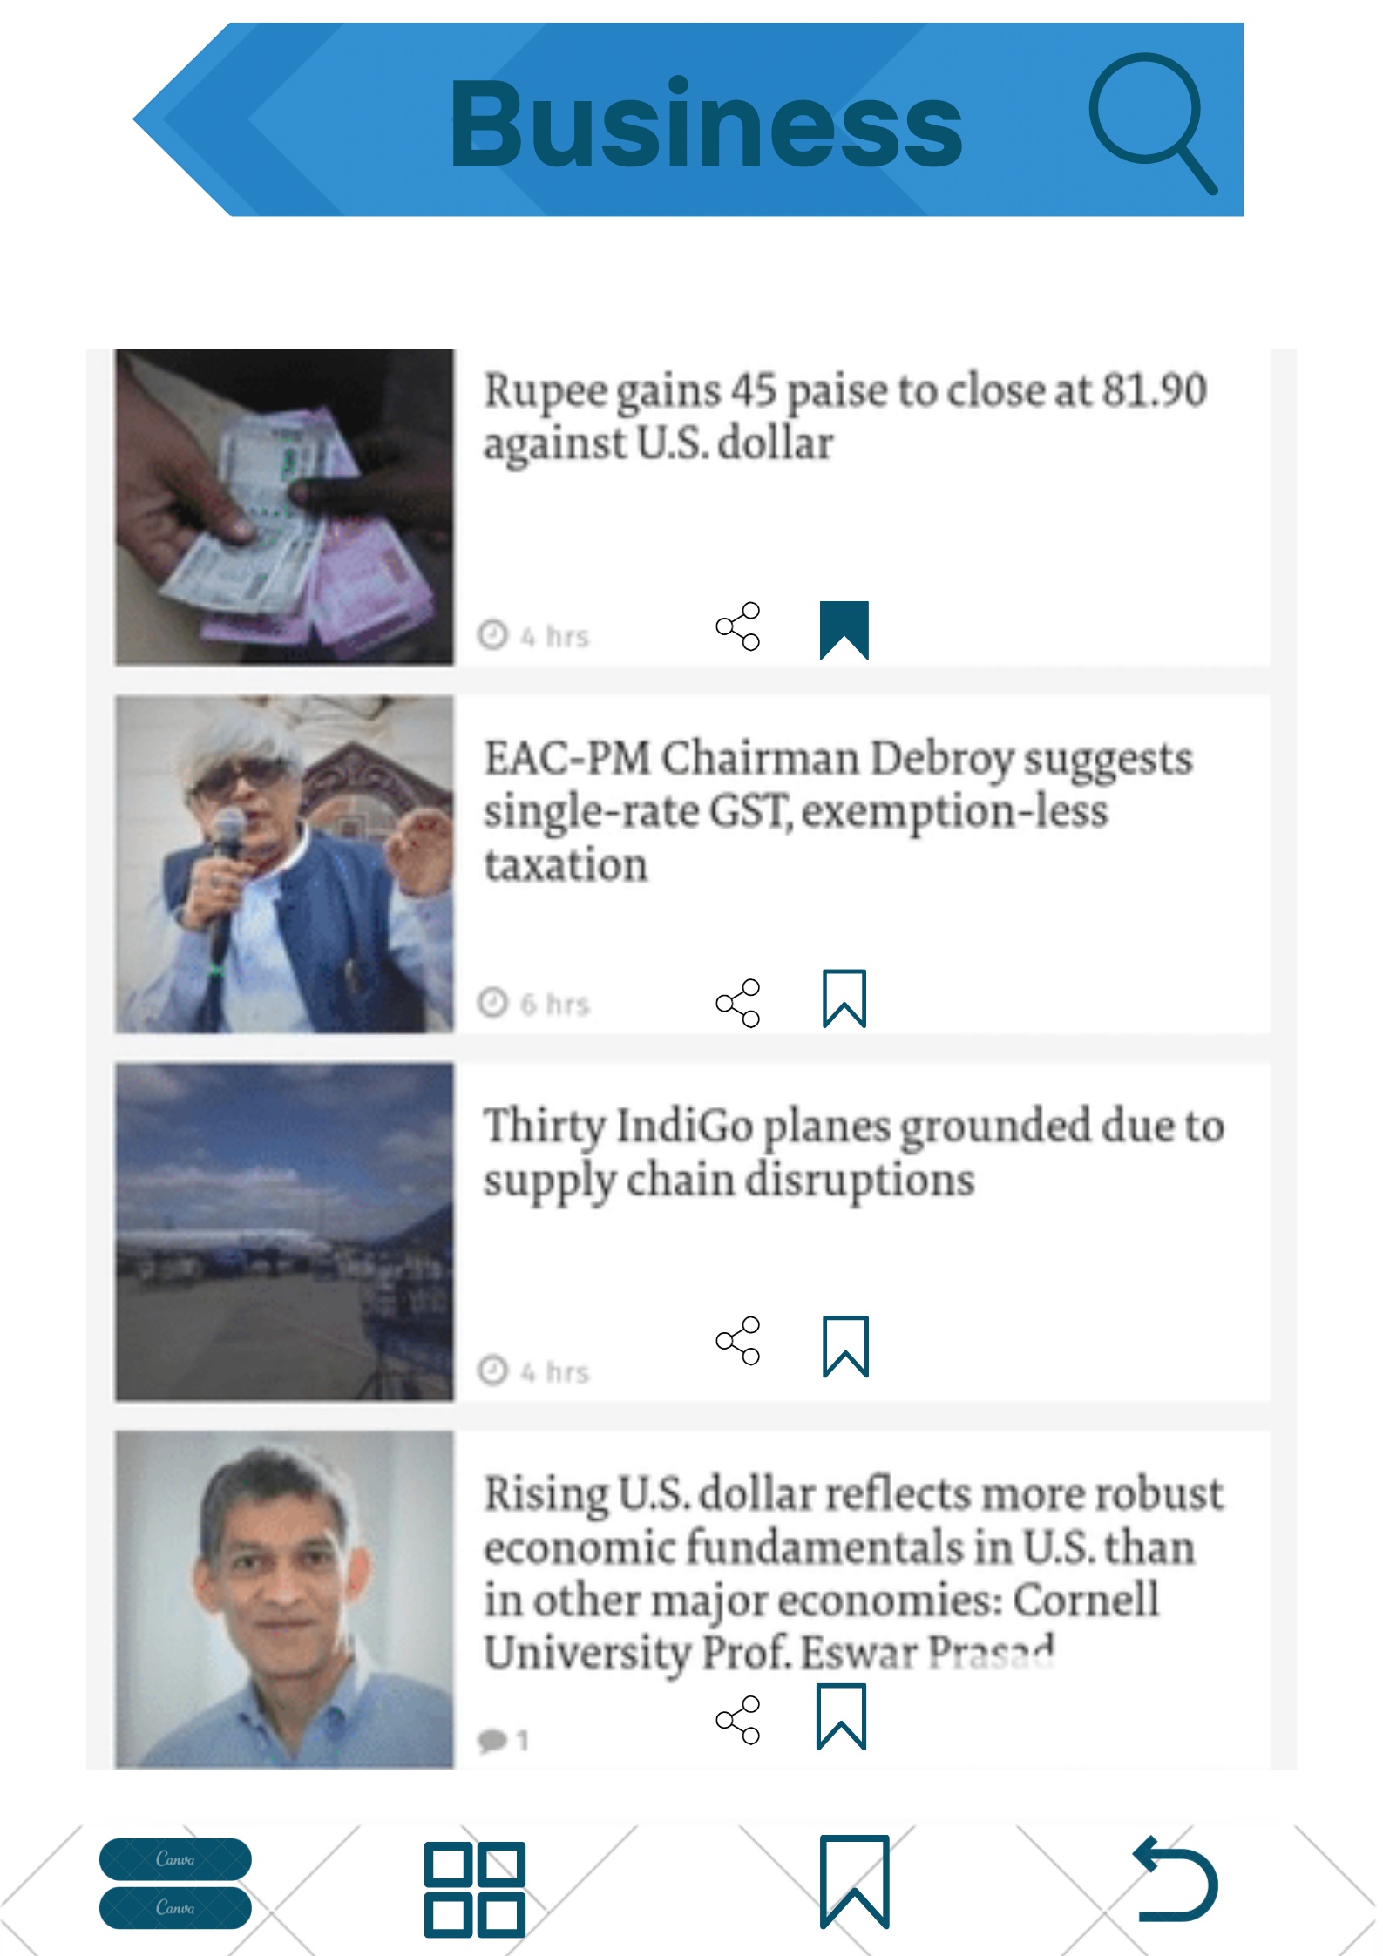
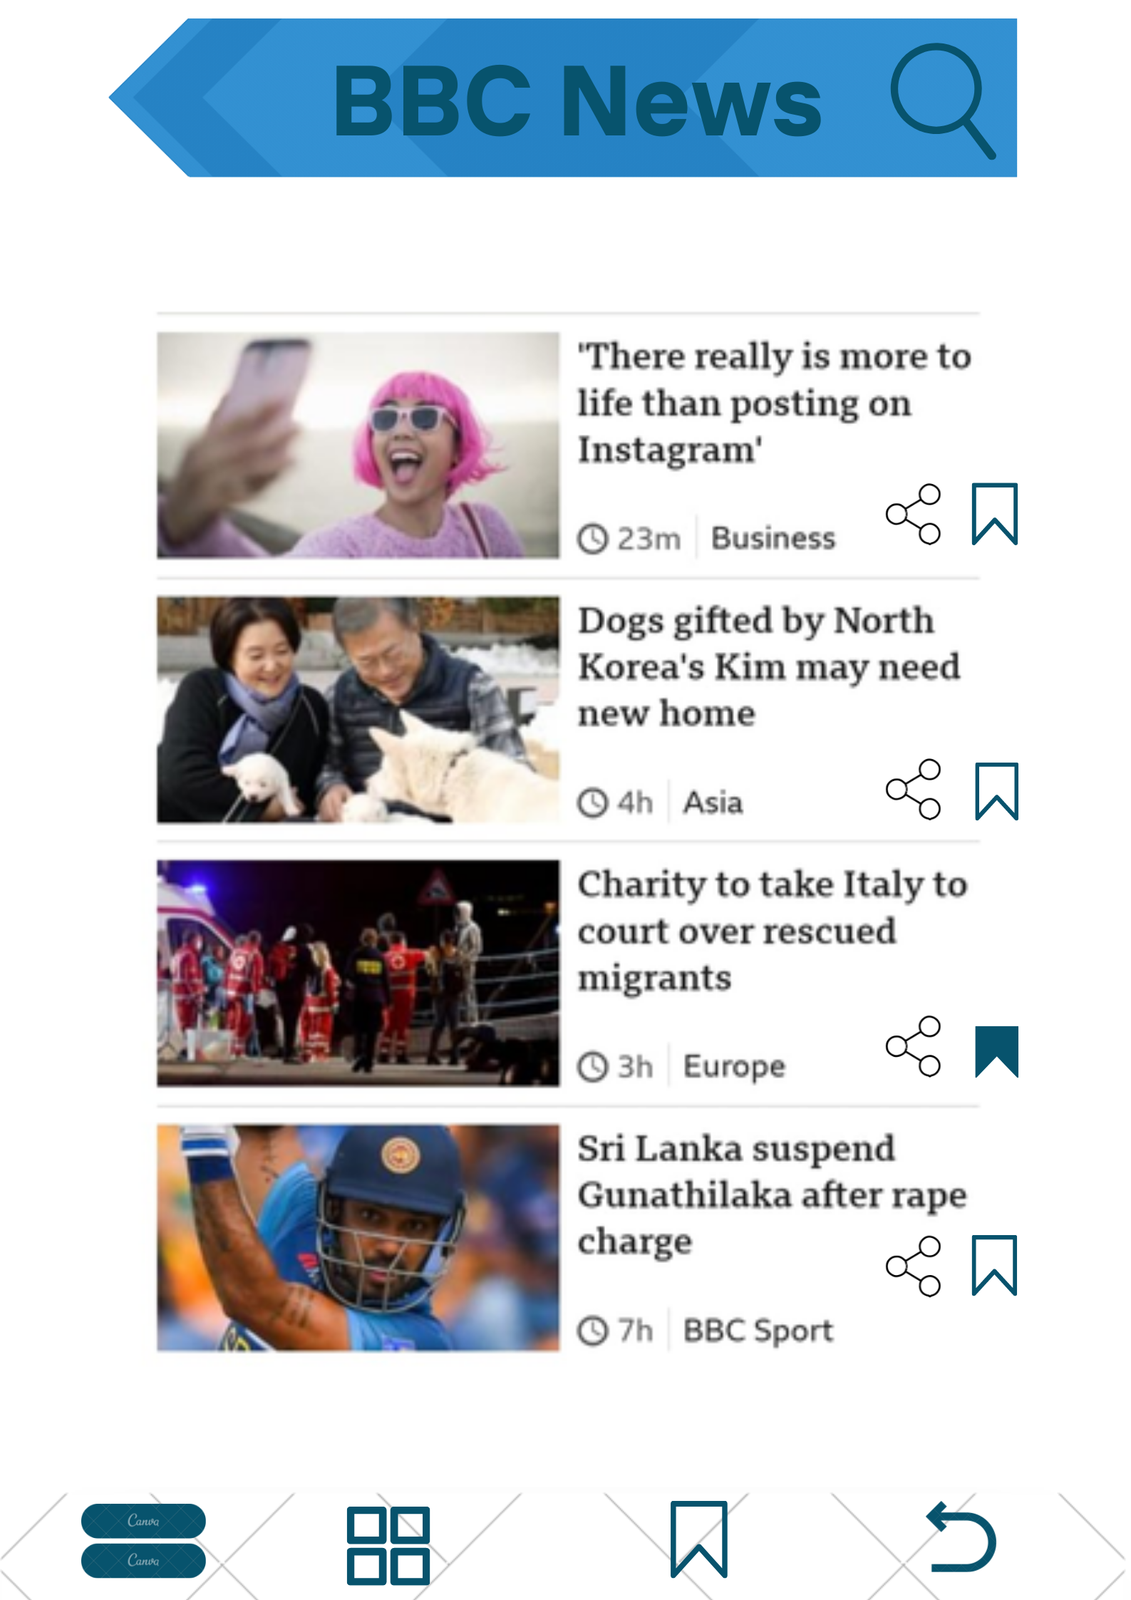
MOCK UI(Continued…)
(5) - When User clicks on the Required
category
(6) - When User clicks on the Required
Channel

Slide 8
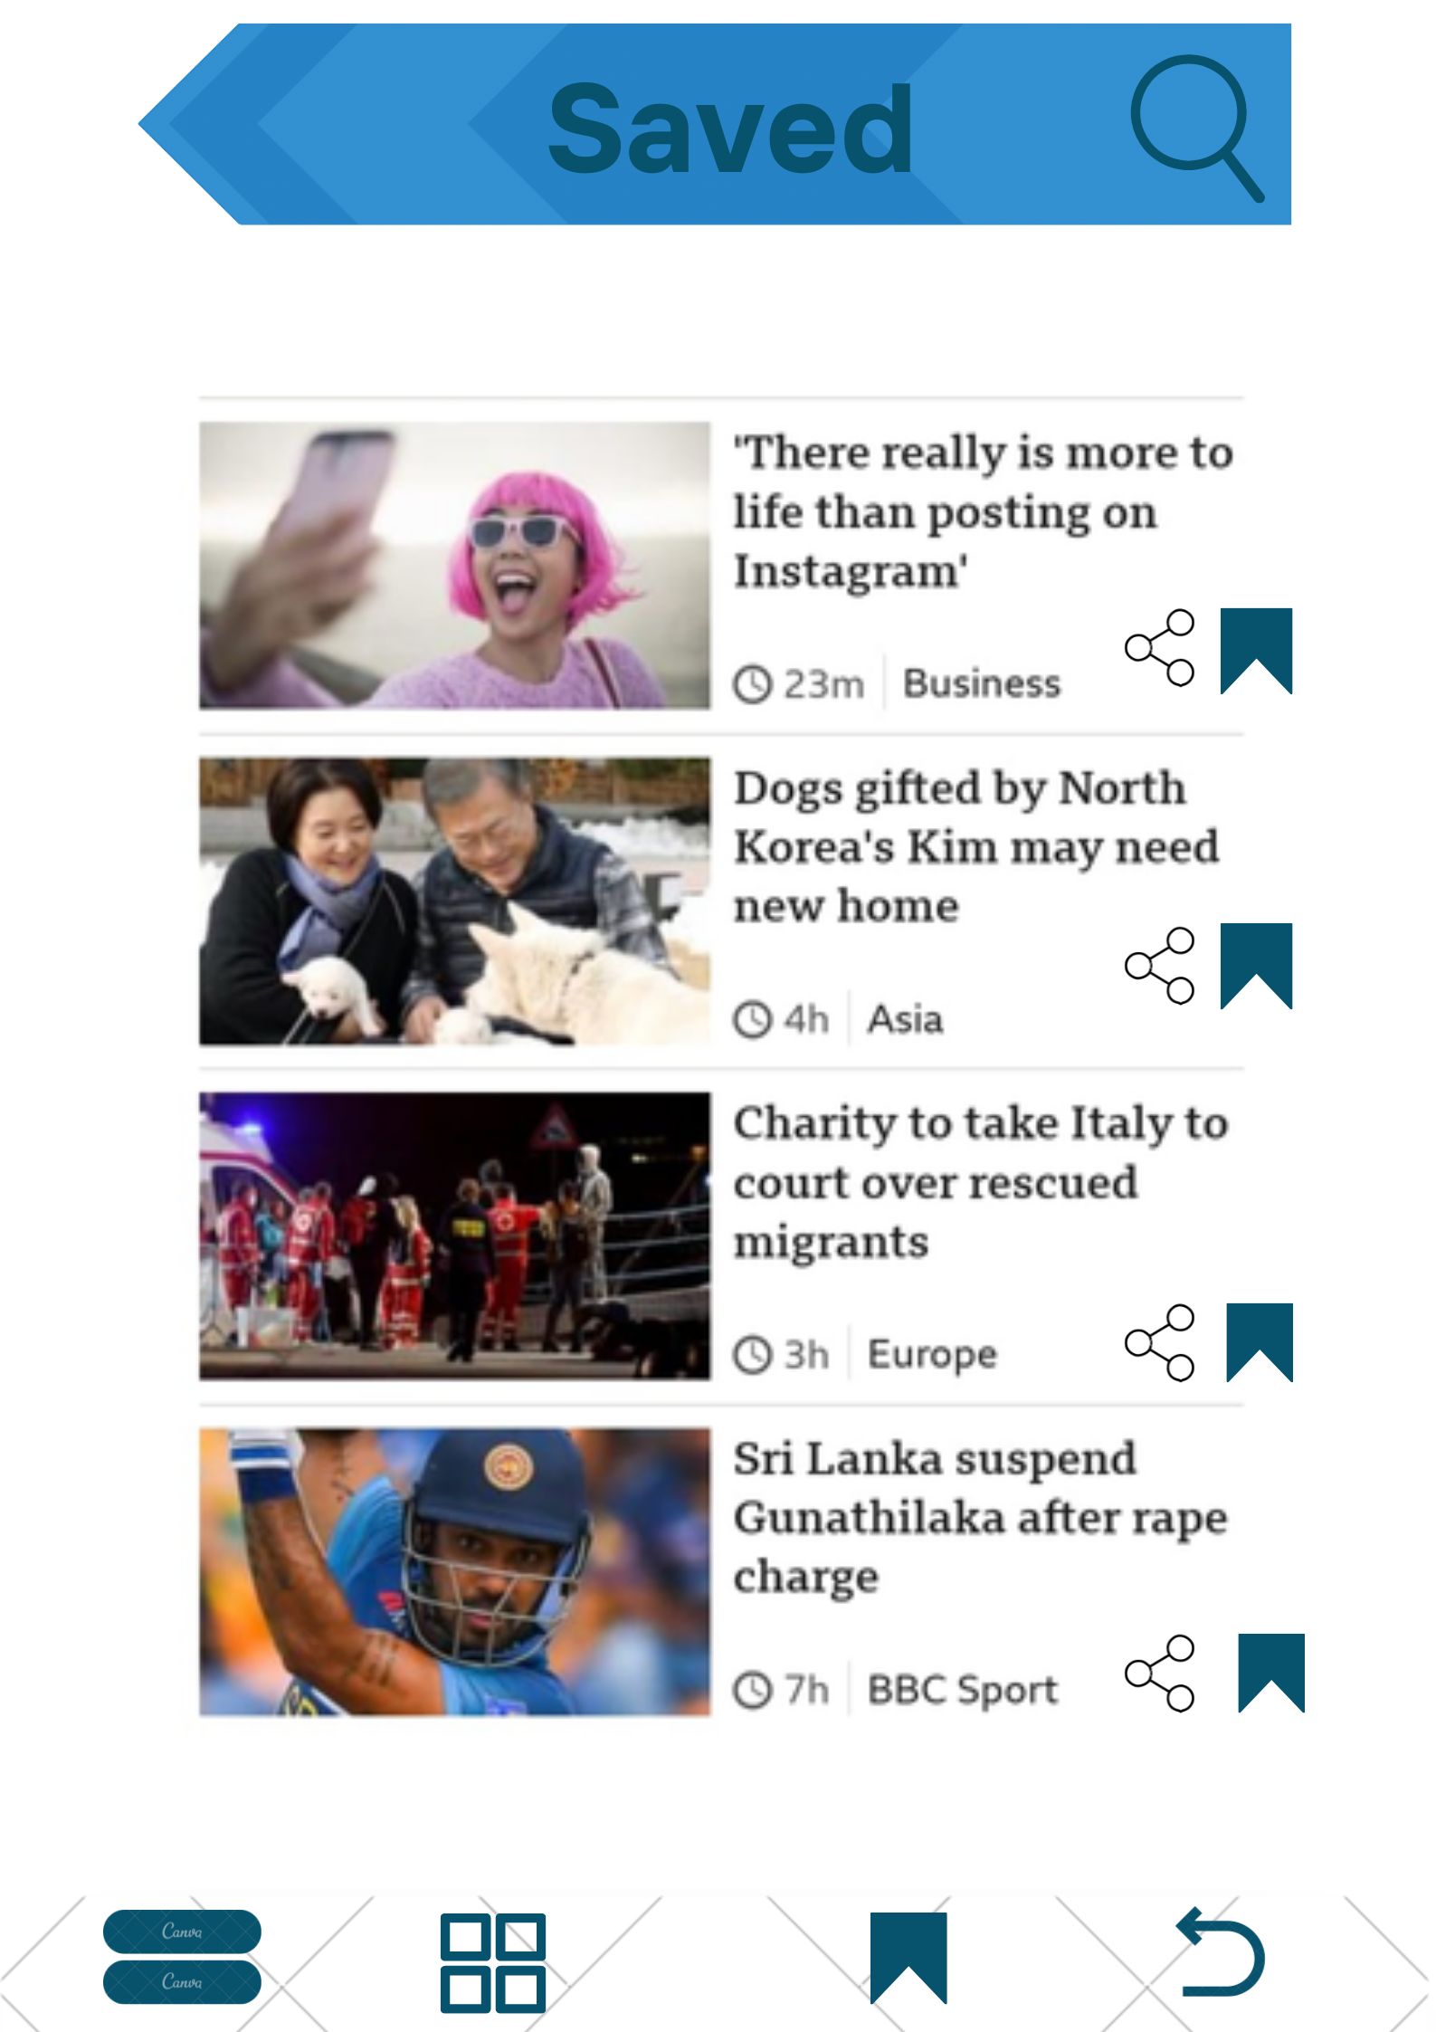
MOCK UI(Continued…)
(7) - When User Clicks on the save icon to see the saved articles

Slide 9

MOCK UI(Continued…)
Video Demo

Slide 10
THANK YOU

